Slide 1

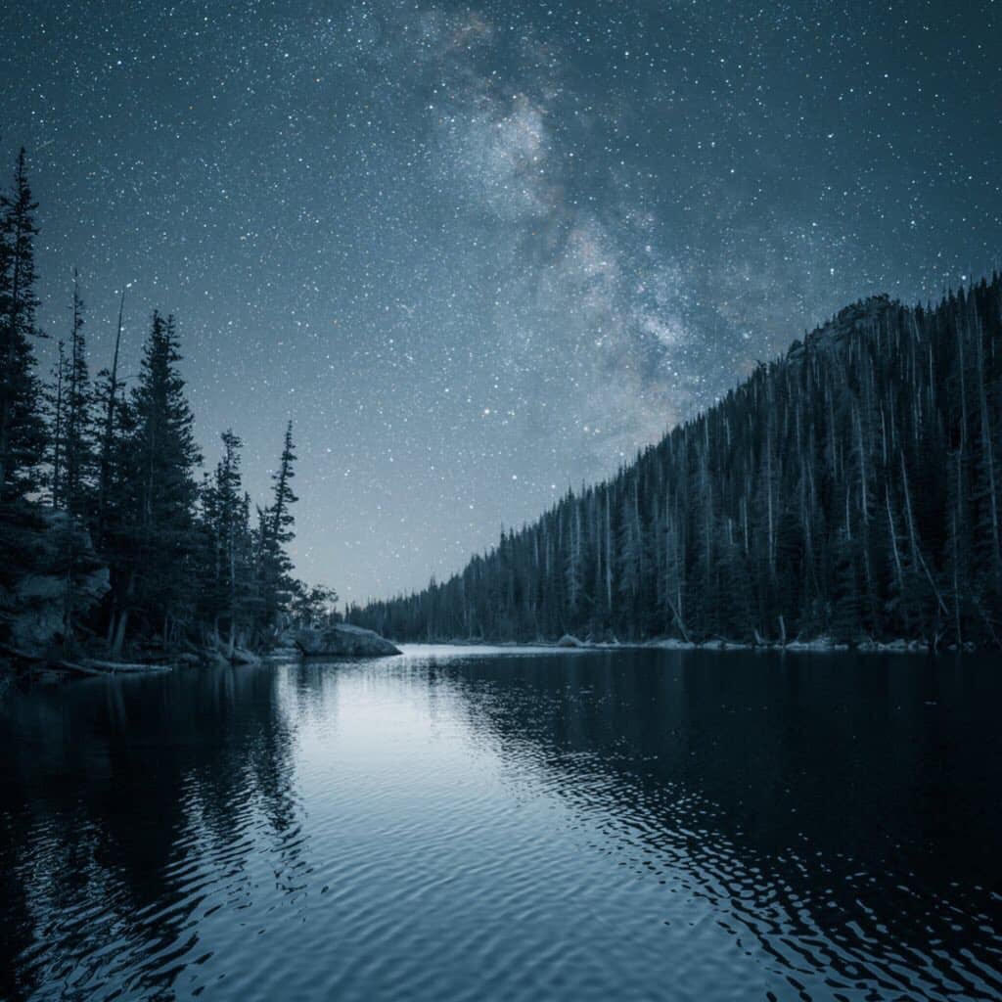
Houston Ray
Charlotte, North Carolina

Slide 2
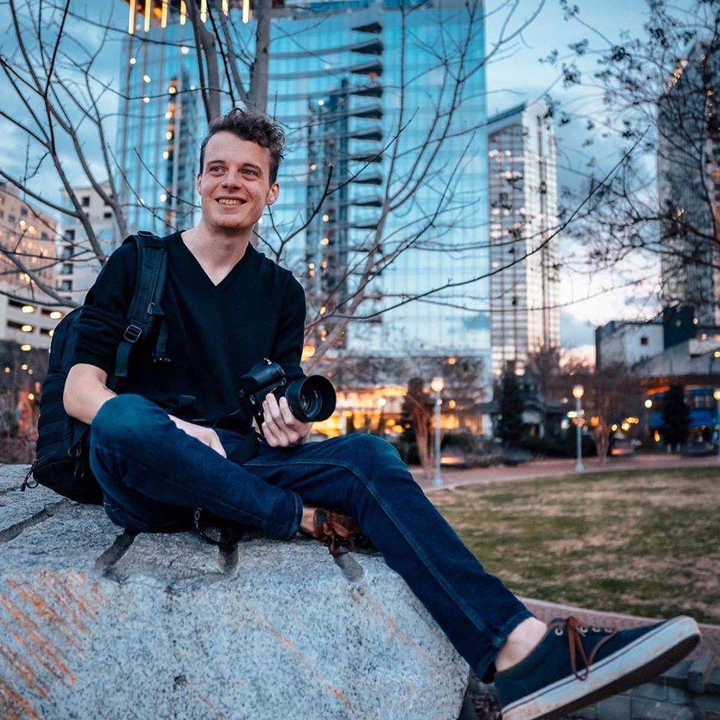
About:
Started in 2017
Style is moody/comfortable
Emphasis on community
Environmental Portraits & Nature
“I Lean towards desaturated, but not edgy. Less making a statement, more of an emotion. Not to gloat or flex.”

Slide 3
Advice:
Link up with other photographers.
Learn from them.
Stay linked with your community.
"Imagine that you're better than you are , that's how you raise the bar."

Slide 4
How Houston Became Famous
Over a 1-2 year progression he has become more insta-famous.
Pushed himself to talk to more people.
Make presence known on social media.
Comment on people's photos.
Funneling Instagram posts onto Facebook.
Currently started a YouTube Tutorial Video teaching how to get moody/dreamy edits using only Lightroom.
A contributor to Unsplash, a website that provides free images for download. Ranked in the top 100, with 25 million views.

Slide 5
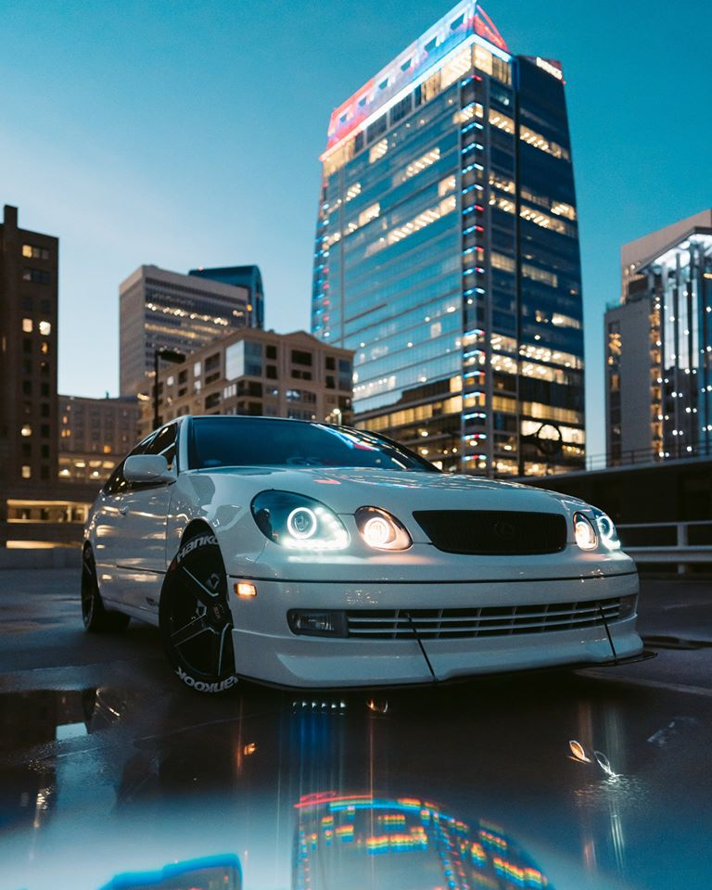
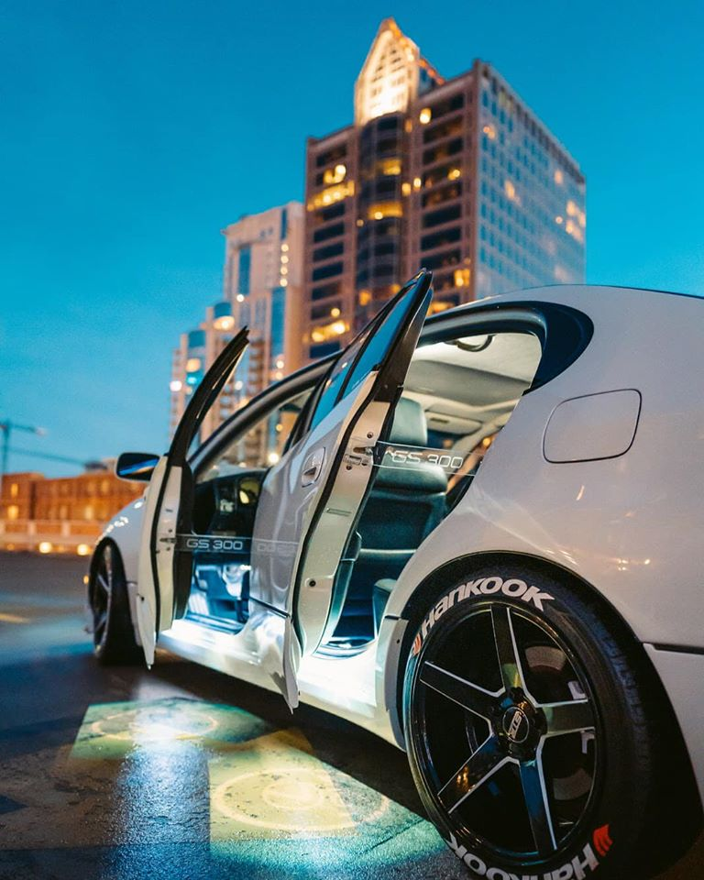

Slide 6
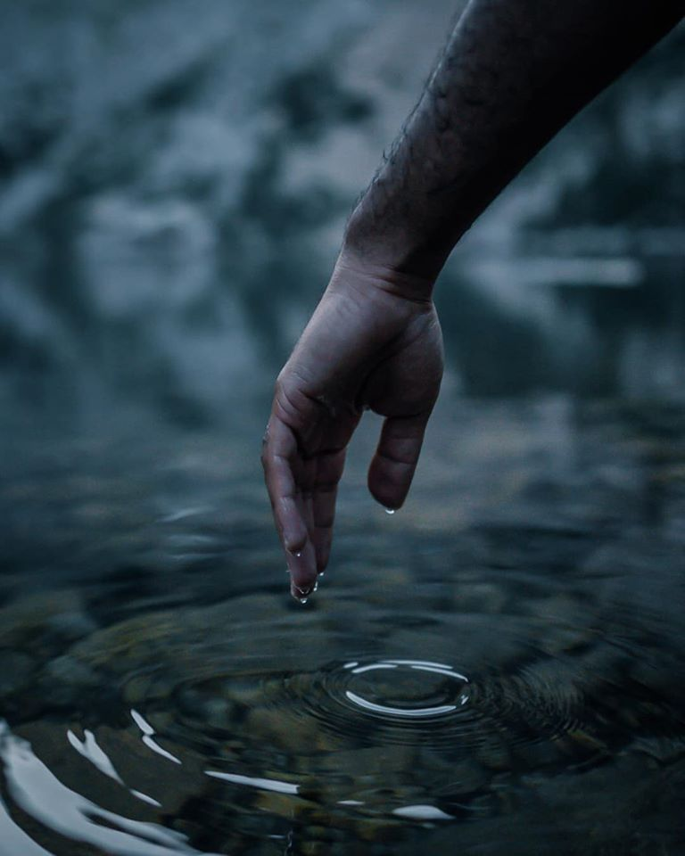
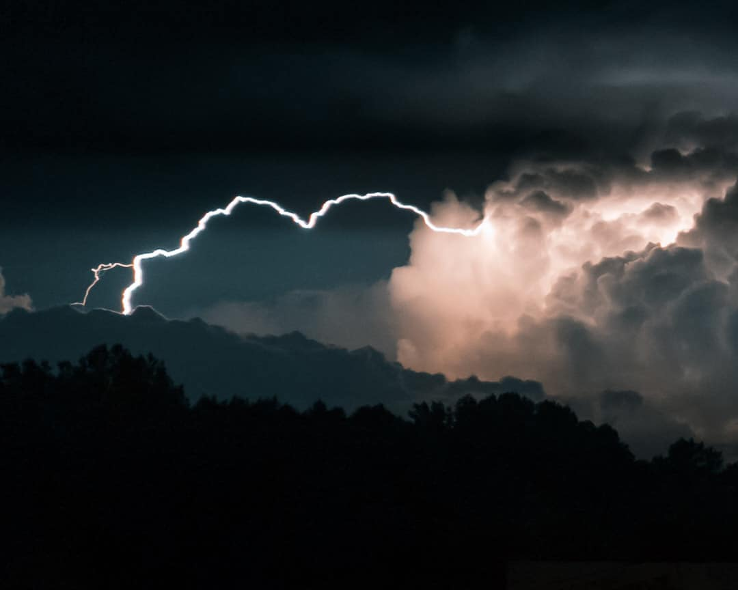
Charlotte, North Carolina
Colorado, Emerald Lake Trial

Slide 7
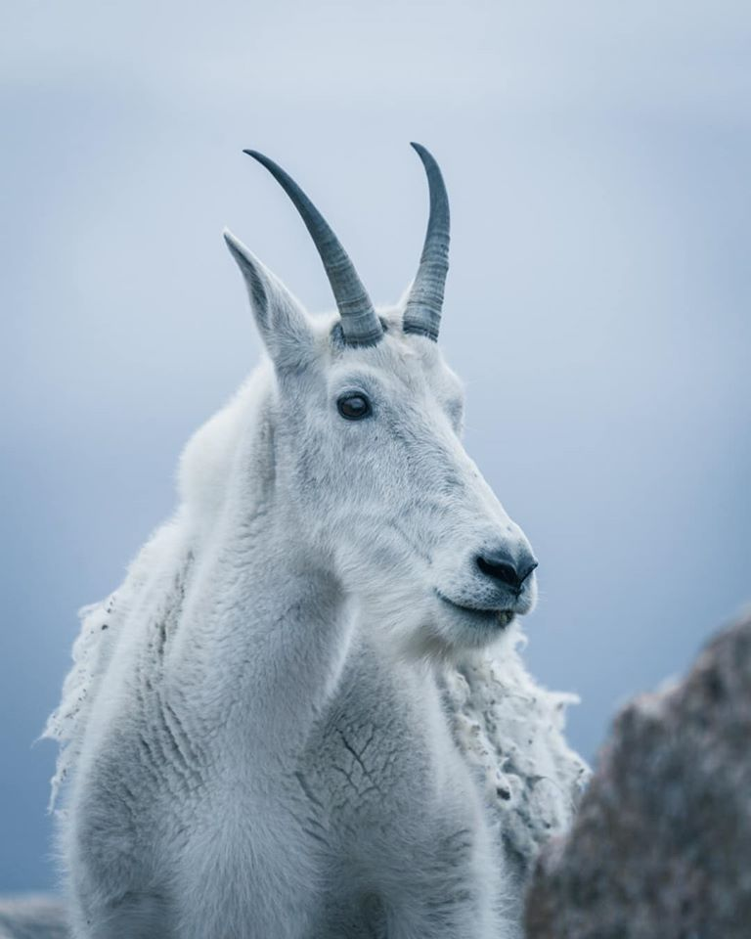
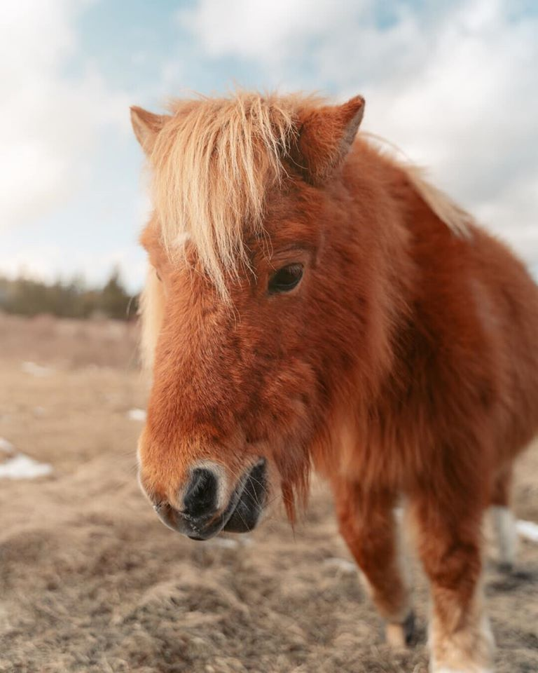
Colorado, Mount Evans
Virginia, Grayson Highlands State Parks

Slide 8
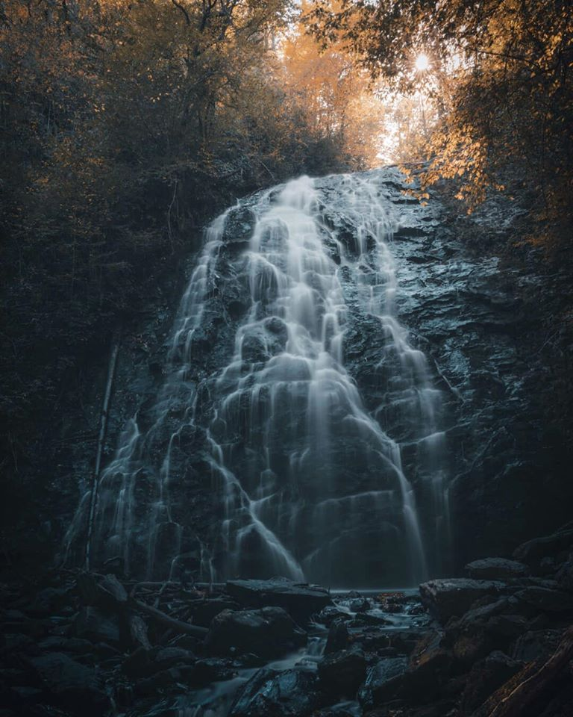
Colorado, Emerald Lake
Blue Ridge Parkway, NC

Slide 9
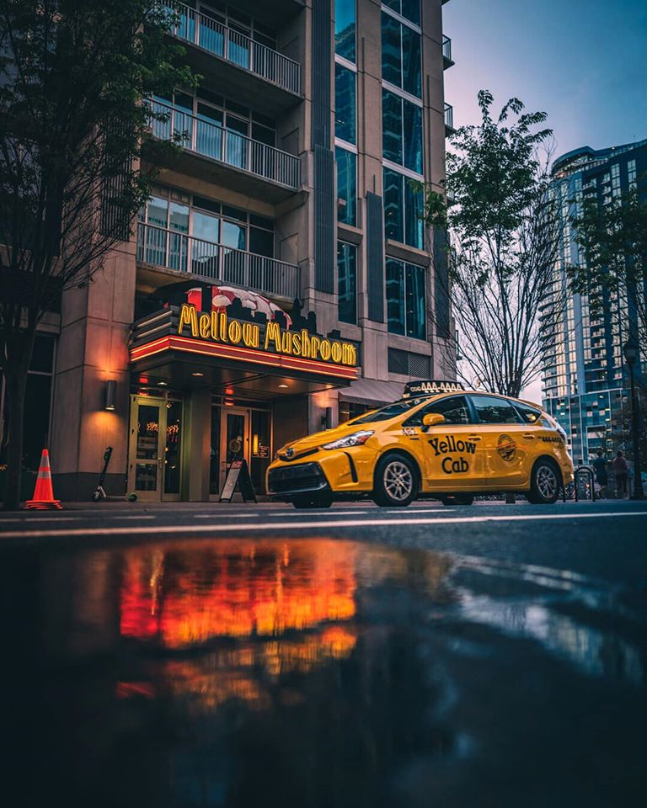
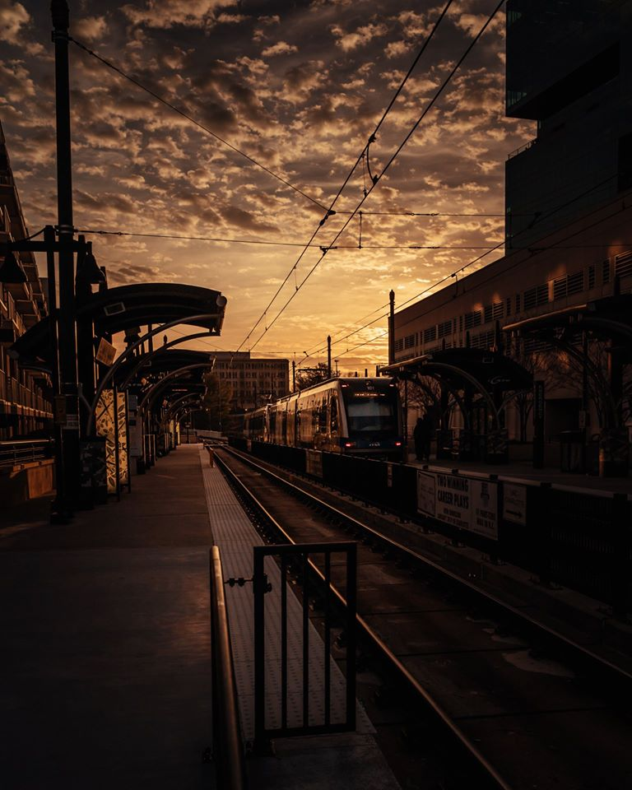
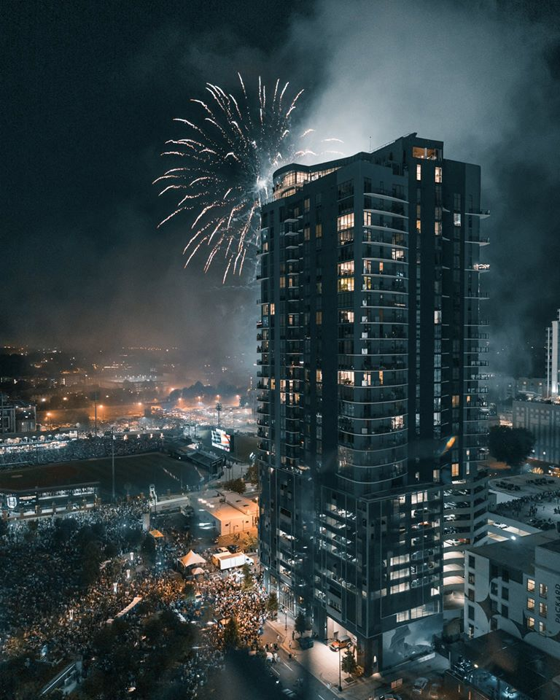
Charlotte, North Carolina

Slide 10
